Slide 1
Module 1

Slide 2
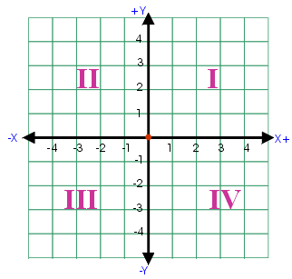
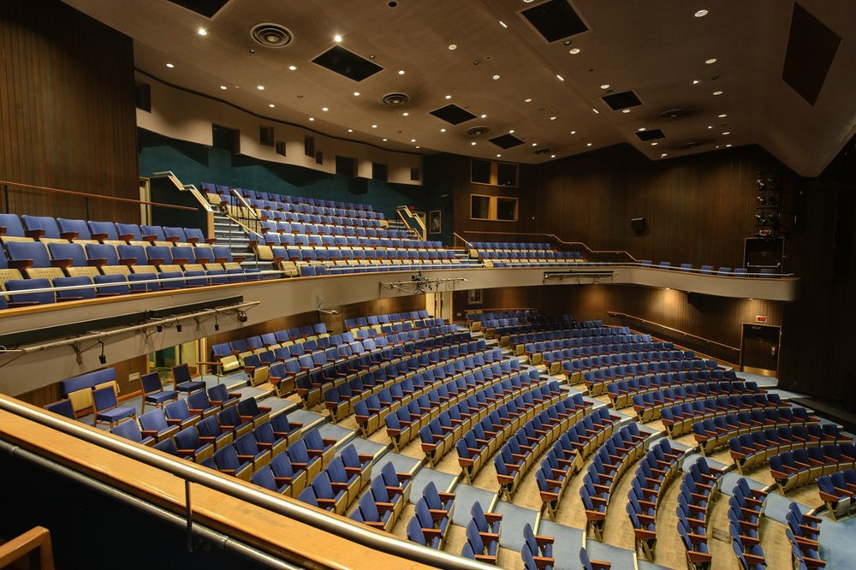
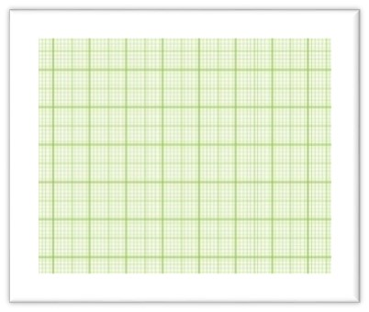
Co-ordinate Geometry
Y
3
2
Distance
1
X′
1
2
3
4
X
Y′

Slide 3

What is Co-ordinate Geometry ?
Co-ordinate geometry is a branch of mathematics which helps us to study the
properties of Geometric figures by placing them on a Co-ordinate plane.
Example : Distance between points,
Area of plane figures,…etc.
Y
5
Distance
4
Area
3
2
1
X′
X
1
2
3
4
5
6
7
8
9
10
11
12
13
14
15
Y′

Slide 4
Let us understand the concept of
co-ordinate plane

Slide 5

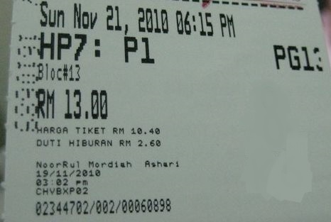
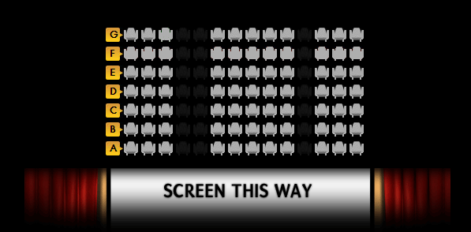
DEMONSTRATION
To locate my seat, I required 2 numbers
ROW NUMBER
COLUMN NUMBER
How do I locate my seat ?
Similarly,
To locate the position of any point in a
plane, we require 2 co-ordinates
X-coordinate
Y-coordinate
Movie Ticket
My Seat Number
ROW
Yeah !!! I found
my Seat
D5
1
2
3
4
5
6
7
8
9
10
11
COLUMN

Slide 6
Module 2

Slide 7
The point at which the line intersects the y-axis is the
Y-coordinate
Now, drop a perpendicular from P on Y-axis
Y
This is Y - axis
Y – coordinate is also called as ordinate
8
Any point in the IInd quadrant will have its
x-coordinate NEGATIVE and y-coordinate POSITIVE
Let us see how to get the X–coordinate of P
7
Let us see how to get the Y–coordinate of P
IInd Quadrant
Ist Quadrant
The points above the Origin on the Y-axis are Positive
Any point in the Ist quadrant will have both its x-coordinate and
y-coordinate POSITIVE
Let us consider a point P in the plane
6
The x – axis and the
y – axis divides the entire plane into 4 quadrants
(–,+)
(+,+)
Q
( , )
5
The point of intersection of X-axis and Y-axis is called Origin and it is denoted by ‘O’
Drop a perpendicular from P on X-axis
–6
4
4
(4,
3)
(X–coordinate,
Y–coordinate)
The points to the left of the Origin on the X-axis are Negative
P
The points to the right of the Origin on the X-axis are Positive
3
The quadrants are numbered in
anti-clockwise direction from the top R.H.S
2
1
Any point in the IVth quadrant will have its
x-coordinate POSITIVE and y-coordinate NEGATIVE
X′
O
X
-10
-9
-8
-7
-6
-5
-4
-3
-2
-1
0
1
2
3
4
5
6
7
8
9
10
Any point in the IIIrd quadrant will have both its x-coordinate and
y-coordinate NEGATIVE
X – coordinate is also called as abscissa
-1
Every point in the coordinate plane has
X – coordinate and
Y – coordinate
-2
The points below the Origin on the Y-axis are Negative
-3
-4
This is X - axis
( , )
-5
R
–5
–5
(–,–)
-6
(+,–)
( , )
The point at which the line intersects the x-axis is the
X-coordinate
S
7
–6
IIIrd Quadrant
-7
IVth Quadrant
-8
Y′

Slide 8
Module 3

Slide 9
Y
8
7
6)
(X–coordinate,
C
(0,
Y–coordinate)
6
5
Here, the point lies on the x - axis
In the coordinate plane, points can also lie on any of the axis
Now drop a perpendicular from A on the y - axis
Let us consider a point C on the y - axis
Here, the point lies on the y - axis
Let us consider a point A on the x - axis
What do you observe about the y – coordinate of A and B
At ‘zero’
so its y – coordinate is ?
Where does it intersect the y - axis ?
Where does it intersect the x - axis ?
4
0
Now drop a perpendicular from C on the x - axis
Let us take another point B on the x - axis
At ‘zero’
so its x – coordinate is ?
It is zero
4
0
Any point lying on the y – axis
will have its x – coordinate ‘0’
So its x – coordinate is
3
?
6
?
So its y – coordinate is
2
1
(4,
0)
B
( , )
A
(X–coordinate,
Y–coordinate)
–5
0
X′
X
-1
0
1
Also the converse, if the x – coordinate
of the point is zero then the point
Lies on the y - axis
-10
-9
-8
-7
-6
-5
-4
-3
-2
2
3
4
5
6
7
8
9
10
-1
-2
D
( , )
0
-3
-3
Any point lying on the x – axis
will have its y – coordinate ‘0’
-4
-5
What do you observe about the x – coordinate of C and D
Now, take another point D on y axis
-6
It is zero
Also the converse, if the y – coordinate
of the point is zero then the point
Lies on the x - axis
-7
-8
Y′

Slide 10
Module 4

Slide 11
Q.
Name the quadrants of the point (-3, -2), (2, -3), (2, 2),
Name the quadrants of the point (-3, -2), (2, -3), (2, 2),
(-5, 2).
(-5, 2).
Soln:
(i)
In the point (–3, –2), abscissa is negative and ordinate is negative. So, it lies in the third quadrant.
(ii)
In the point (2, –3), abscissa is positive and ordinate is negative. So, it lies in the fourth quadrant.
What is the sign of
its y co-ordinate ?
What is the sign of
its x co-ordinate ?
-
-
(iii)
In the point (2, 2), abscissa is positive and ordinate is positive. So, it lies in the first quadrant.
What is the sign of
its y co-ordinate ?
What is the sign of
its x co-ordinate ?
-
+
What is the sign of
its y co-ordinate ?
(iv)
+
In the point (–5, 2), abscissa is negative and ordinate is positive. So, it lies in the second quadrant.
What is the sign of
its x co-ordinate ?
+
So, the point (-3,-2) lies
in which quadrant ?
IIIrd Quadrant
What is the sign of
its y co-ordinate ?
What is the sign of
its x co-ordinate ?
+
-
So, the point (2,-3) lies
in which quadrant ?
IVth Quadrant
So, the point (-5, 2) lies
in which quadrant ?
So, the point (2, 2) lies
in which quadrant ?
IInd Quadrant
Ist Quadrant

Slide 12
(ii) Which of the following points will lie on X- axis or Y- axis?
Which of the following points will lie on X- axis or Y- axis?
A(0, 2), B(5, 0), C(4.5, 0), D (0, 3.2).
A(0, 2), B(5, 0), C(4.5, 0), D (0, 3.2).
Soln :
(i)
The point (0, 2) lies on the y - axis.
(ii)
The point (5, 0) lies on the x - axis.
Its x co-ordinate is zero
(iii)
The point (4.5, 0) lies on the x - axis.
Its x co-ordinate is zero
Its y co-ordinate is zero
(iv)
The point (0, 3.2) lies on the y - axis.
Its y co-ordinate is zero
So, the point (0, 3.2) lies
on which axis ?
Y -axis
So, the point (5, 0) lies
on which axis ?
So, the point (0, 2) lies
on which axis ?
X -axis
Y -axis
So, the point (4.5, 0) lies
on which axis ?
X -axis

Slide 13
Thank You

